Slide 1



STUDENT PLACEMENT CHANCE PREDICTION
USING ANN
Presented by
Batch Number: 5
B. Sumith Babu 17H61A04D1
G. Arjun Kumar 17H61A04D7
J. Sujatha 18H65A0426
DEPARTMENT OF ECE
Domain:
Deep learning, Web development
Under the guidance of
Mr. B. Santhosh Kumar
Assistant Professor
AGI

Slide 2

abstract
All students dream to obtain a job offer in their hands before they leave their college. A placement chance predictor helps students to have an idea about where they stand and what to be done to obtain a good placement. A placement predictor is a system that could predict the possibility or the type of company a pre-final year student has chances to be placed. Thus a prediction system could help in the academic planning of an institution for future years. This project presents an approach for using deep learning algorithm to make a placement prediction model for pre-final year engineering graduate students

Slide 3
OBJECTIVES
To build web application for placement exam.
To predict the student placement chance
To encourage the student to improve themselves in particular field.

Slide 4
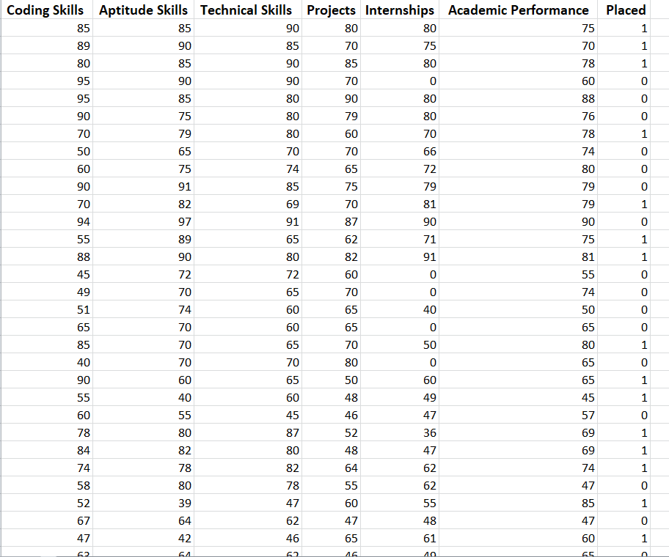
Data set
Dataset attributes used in our project
Coding Skills
Aptitude Skills
Technical Skills
Projects
Internships
Academic Performance
Placed

Slide 5
Methodology
All companies in the IT sector spend a large amount of its total capital in recruiting the students to its company. Thus it is necessary to find an alternative process of filtering to reduce the capital cost that is used for this process. Effective filtering of students could be performed by applying various deep learning tools on the student details. This system defined the meaning of deep learning in the field of education as a method of identifying, discovering and capturing the unknown similarities or patterns from a dataset by using an ensemble combination of various analytical approaches. It is possible for an educational institute to exploit this data mining feature to figure out the recruitment policy of a company from previous year placement statistics and student dataset. Thus it is very important to conduct a study on various placement prediction systems.

Slide 6
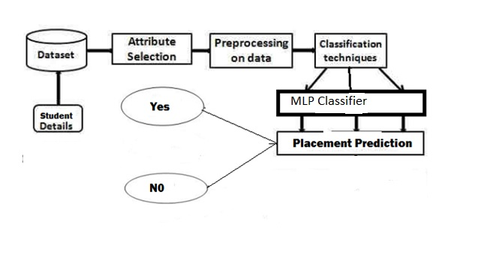
Block Diagram
Fig 1 Proposed Method

Slide 7
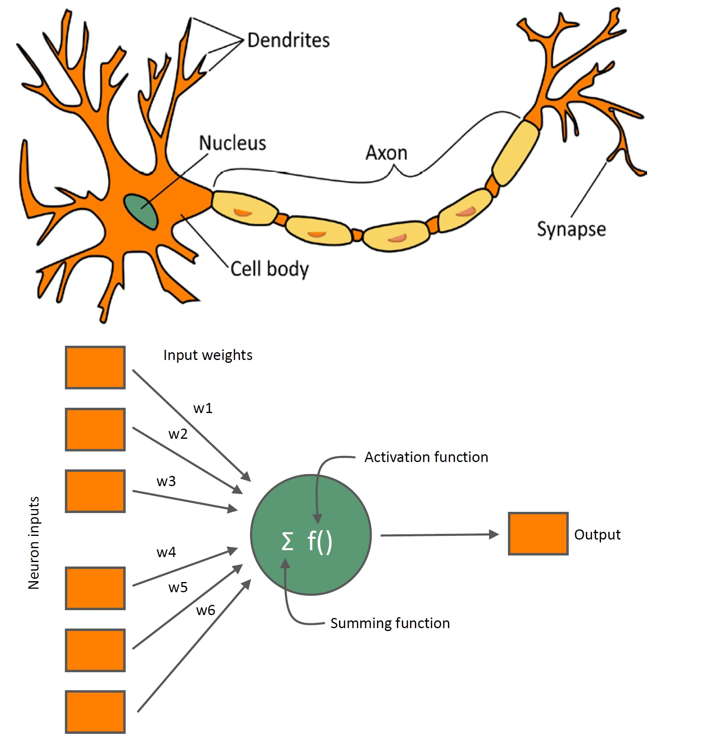
Artificial Neural NEtwork
Fig 2. Neuron

Slide 8
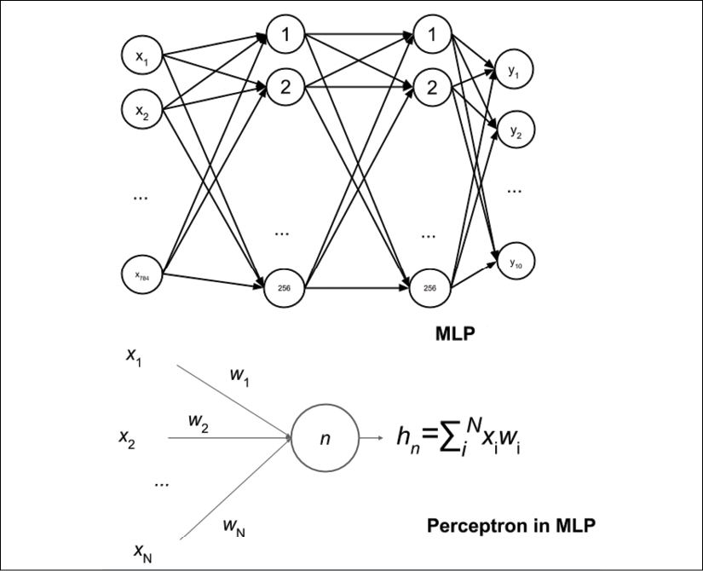
Multi Layer Perceptron
Fig 3 Multi Layer Perceptron

Slide 9
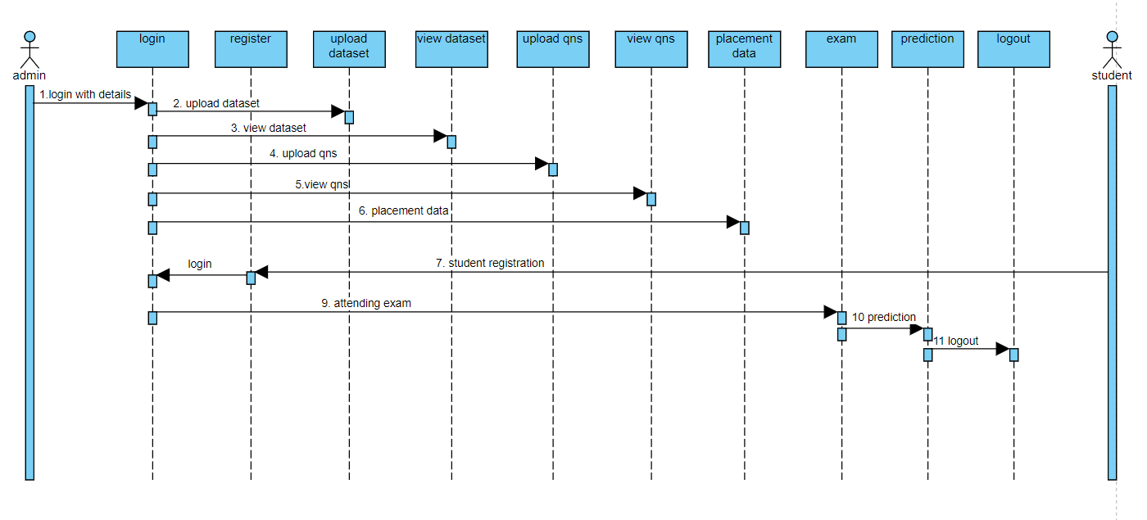
Sequence of operation
Fig 4. Sequence of operation

Slide 10
Software and Hardware requireMent
Hardware | Software
Processor – i5- 8th generation RAM- 8gb Hard disk- 1TB Keyboard – Standard Keyboard | Operating System- Windows 10 Web Technologies- HTML5,CSS,JavaScript Database – MySQL

Slide 11

Result

Slide 12
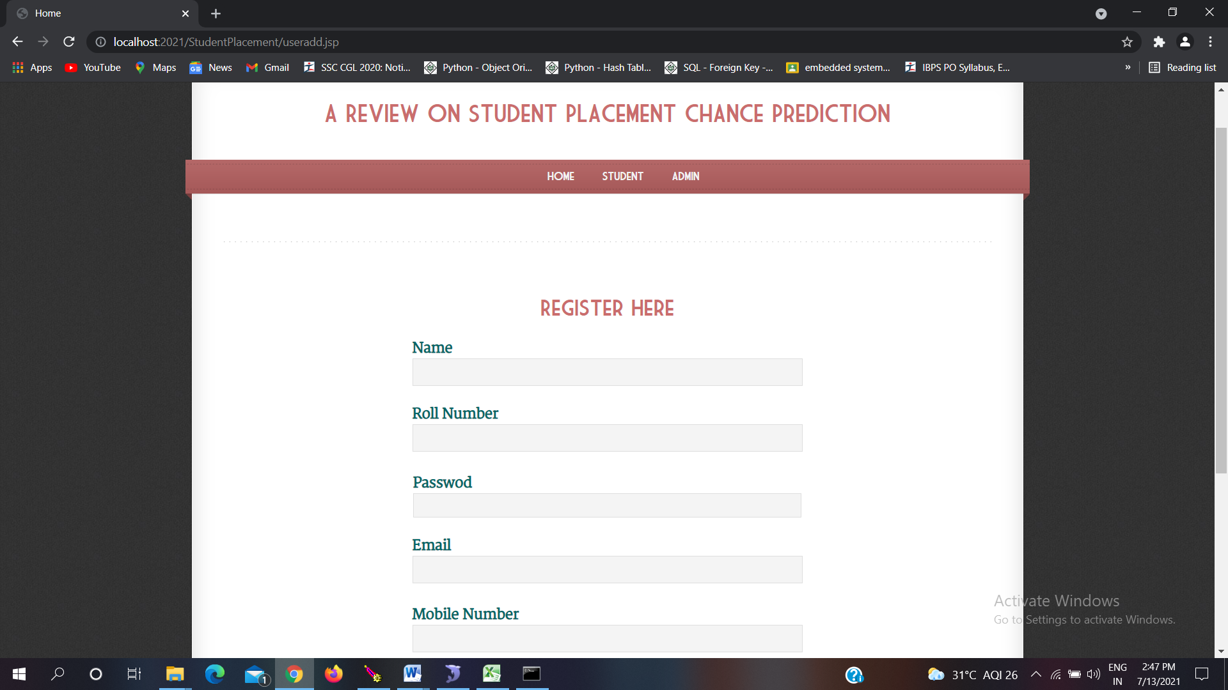
result
Fig 5. Student Registration form

Slide 13
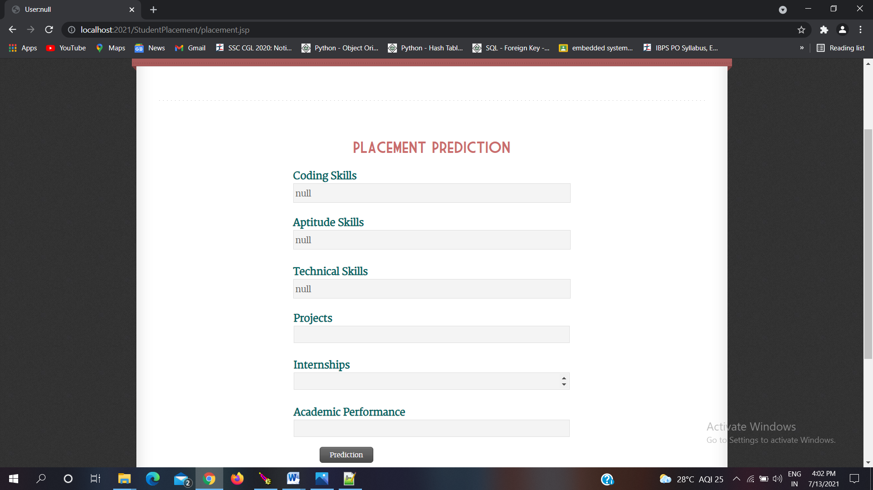
result
Fig 6 Placement prediction

Slide 14
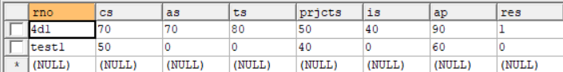
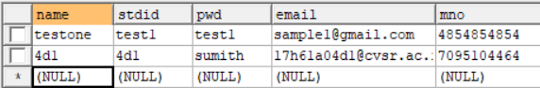
result
Fig 7. Student placement details
Fig 8. Student Login details

Slide 15
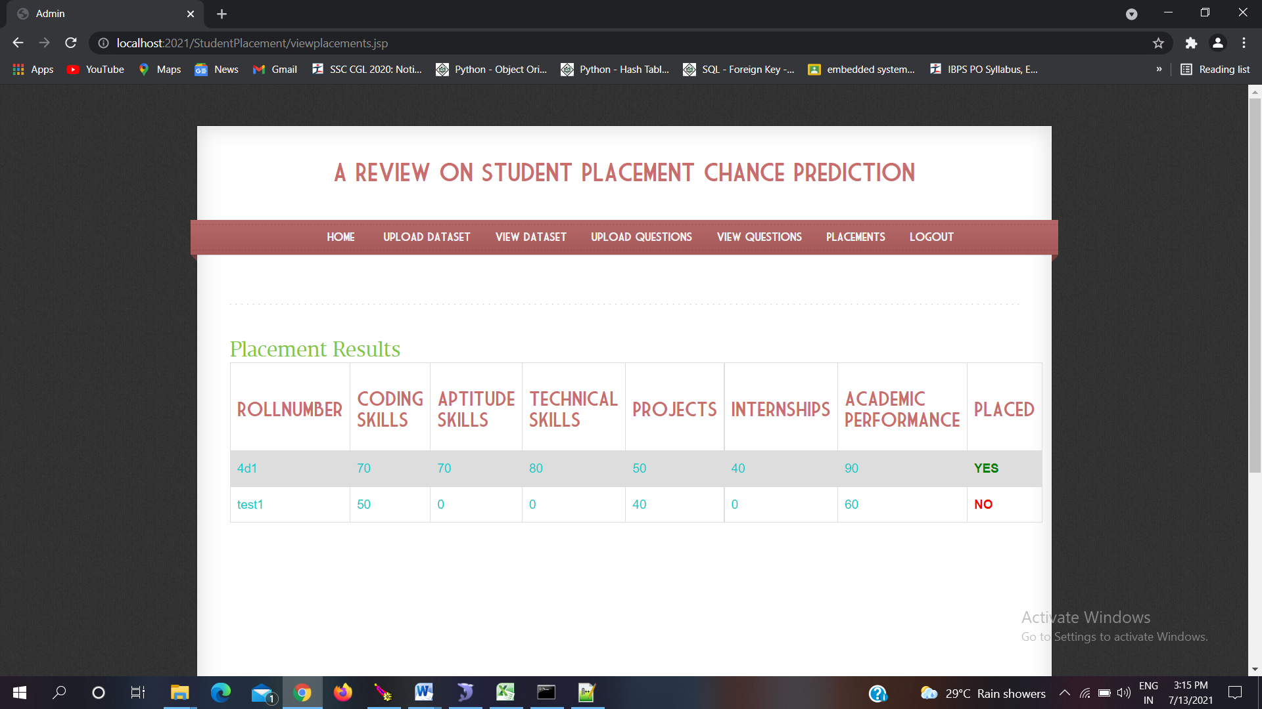
result
Fig 7. Student placement details on admin side

Slide 16
APPLICATION
Fig.2: Block diagram representing components used in the project
College own website for student performance prediction
Probability of increase in placement.
We can classify in what perspectives or topics the students are weak and make them to concentrate on that topics.

Slide 17
Conclusion and Future Scope
Fig.2: Block diagram representing components used in the project
This prediction can enlighten students to identify their capabilities and improve accordingly.
This system also helps in the academic planning of an institution to prepare proper strategies and improve the placement statistics for the future years.
We can also predict which company picks which category of students.

Slide 18
REFERENCE
[1]L. C. Joy and A. Raj, "A Review on Student Placement Chance Prediction," 2019 5th International Conference on Advanced Computing & Communication Systems (ICACCS), 2019, pp. 542-545, doi: 10.1109/ICACCS.2019.8728505.
[2] Thangavel, S. Bkaratki, P. Sankar, “Student placement analyzer: A recommendation system using machine learning”, Advances in Computing and Communication Systems (ICACCS-2017) International Conference on. IEEE, 2017.

Slide 19
Thank you

